Slide 1
Lecture 1:
Introduction to Database Management Systems
Notes:
1

Slide 2
Historical Roots: Files and the File System
Manual file systems used to be the basic data management tool:
Contents of each file folder are logically related
File systems composed of a collection of file folders, each tagged and kept in cabinet
Organized by expected use
Example: doctor office has a file for each patient
As the volume of data grows,
It becomes more complex to keep track of everything
It becomes harder to look for information
Time-consuming
Unlikely to generate accurate useful information
Computerized file system is an improvement over the manual file system:
Developing software to manage the data
Each file has its own application program to store, retrieve, modify data

Slide 3
Dealing with Files
Requires extensive programming
A program specifies WHAT needs to be done and HOW to do
If you want to extract information:
A program needs to be written to answer each query
Answer to a query will be available “next week” or “next month”

Slide 4
Dealing with files (cont’d)
Changing one field in the student file
(e.g., changing the student ID from string to number):
Read a record from the original file
Transform the original data to conform to the new structure’s storage requirement
Write the transformed data into the new file structure
Repeat steps 1 to 3 for each record in the original file
Modify all programs that access data in that file

Slide 5
Problems with the file system (1)
Difficulty in accessing data:
Requires extensive programming
Each file needs a special program to read, store, or modify data
Each question (or query) needs a special program to answer:
Impossible to support ad-hoc queries
System administration is complex and difficult
Security and privacy features are difficult to program:
Needs the ability to lock parts of the file

Slide 6
Problems with the file system (2)
Data redundancy:
Means that same data is stored unnecessarily in different places
Organizational structure promotes storage of same data in different locations
Example: Course’s name and number is stored with all students who are taking the same course
In earlier years, storage was expensive.
Data that is stored in different locations unlikely to be updated consistently

Slide 7
Example: Course Registration File
J0100, Jones, Minneapolis, ICS 311, Database, 4
PE100, Tammy, St. paul, ICS311, Database, 4
MA100, Smith, Edina, ICS141, Programming, 3
J0100, Jones, Minneapolis, ICS141, Programming, 3
PE100, Tammy, St.Paul, ICS240, Algorithms, 4

Slide 8
Effects of Data Redundancy
Data inconsistency:
different and conflicting versions of same data occur at different places
Data anomalies:
abnormalities when all changes in redundant data not made correctly
Update anomalies:
Updating course’s number requires updating records for all students that take that course
Inconsistency will happen if not updated in one record
Insertion anomalies:
Inserting a new course requires having empty student fields
Empty fields create high potential for data inconsistency
Deletion anomalies:
Deleting a student will delete the corresponding course’s data which is undesirable

Slide 9
Problems with the file system (3)
Integrity problems
Integrity constraints (e.g., account balance > 0) become “buried” in program code rather than being stated explicitly
Hard to add new constraints or change existing ones
Data isolation:
Data is scattered in multiple files with different formats.
Writing new applications to retrieve the data is not easy
Notes:
9

Slide 10
Problems with the file system (4)
Atomicity of updates
Failures may leave the data in an inconsistent state with partial updates carried out
Example:
Transfer of funds from one bank account to another should either be reflected in both accounts or not happen at all
Concurrent access by multiple users
Concurrent access needed for performance
Uncontrolled concurrent accesses can lead to inconsistencies
Examples:
Two people reading a balance (say 100) and updating it by withdrawing money (say 50 each) at the same time
Two students are trying to register in a course in the same time while there is only one space left in the course
Notes:
10

Slide 11
Problems with the file system (5)
Structural dependence:
Access to a file is dependent on its own structure
Example:
Adding a new field to a record
All programs must be modified to conform to a new file structure
Structural independence means changing file structure without affecting data access
Data dependence:
Data access changes when data storage characteristics change
Example: changing a filed from integer to string requires changing all programs that deals with this field
Data independence means data storage characteristics do not affect data access

Slide 12
What is the solution? Database
A Database is a shared, integrated computer structure that stores two types of data:
Data: end-user raw facts of interest to the end user (stored in tables)
Metadata: data about data
Metadata provides description of data characteristics and relationships in data
Example:
Name of data elements: student_name
Type: integer, string
Can it be empty?
Stored in Database Catalog or Data Dictionary

Slide 13
History of Databases
1950s and early 1960s:
Data processing using magnetic tapes for storage
Tapes provided only sequential access
Punched cards for input
Late 1960s and 1970s:
Hard disks allowed direct access to data
Network and hierarchical data models in widespread use
Ted Codd defines the relational data model
Won the ACM Turing Award for this work
IBM Research begins System R prototype
UC Berkeley begins Ingres prototype
High-performance (for the era) transaction processing
Notes:
13

Slide 14
History (cont’d)
1980s:
Research relational prototypes evolve into commercial systems
SQL becomes industrial standard (What does SQL stand for?)
Parallel and distributed database systems
Object-oriented database systems
1990s:
Large decision support and data-mining applications
Large multi-terabyte data warehouses
Emergence of Web commerce
Early 2000s:
XML and XQuery standards
Automated database administration
Later 2000s:
Giant data storage systems
Google BigTable, Yahoo PNuts, Amazon, ..
Notes:
14

Slide 15
What is a Database Management Systems?
A DBMS provides all the functionality that is required to manage the data that is stored in the database
Eliminates file system problems
Reduces data redundancy, hence reducing data inconsistency
Example DBMS Systems:
Oracle
Microsoft SQL
MySQL
Users focus on WHAT they need to do on the data, but not HOW to do:
Improved decision making
Increased end-user productivity

Slide 16


Database Applications
Common Properties and Requirements
Large data sizes
Various querying capabilities
Concurrent access
Data security
Data administration
University
Students, Courses, Registration, Grades
Airlines
Flights, Reservation, Schedules,
A Database Management System (DBMS) is a software package that is designed to store and manage databases
Digitized Data
Banking
Deposit, Withdrawal, All transactions
Retail
Stores, Prices, Quantities, Sales

Slide 17
Database Design
Database design is the process of defining the structure that is used to store the data
Example 1: University database
What are the units in the university that we need to store data about?
students, faculty, staff, and courses
What is the information that needs to be stored for each unit?
Name, Identifier, login, address, etc.
What are the relationships that relate these units?
Students take courses
Faculty teach courses
What are the university policies?
Each student should have an adviser from faculty members
A student can register in a course only if the student completes the course’s prerequisites
What are the operations that are to be done on the data?
Student registration
Course Drop
Course registration

Slide 18
Example 2: A Company database
What are the units in the company that we need to store data about?
Employees, Managers, Departments, Buildings, and Products
What is the information that need to be stored for each unit?
Employees: Name, Address, ID, department
Products: Name, Price, quantity in stock
What are the relationships that relate these units?
A Department can produce more than one Product
An Employee works in one Department
A manager manages a department
What are the company policies?
A department can produce at least 10 products
A product is produced by only one department
What are the operations that are to be done on the data?
Hiring a new employee,
Promoting an employee to be a manager
Producing extra quantity of the same product
Producing a new product

Slide 19
Database Design (continued)
Database design depends on the database’s expected use:
Do you need to store the student’s or faculty car model?!!
Do you need to know the number of family members for each faculty?!!
Good design decisions are very important:
Poorly designed database:
Cause difficult-to-trace errors
Example:
Including “age” with the students information
Age is continuously changing
It is better to include DOB
Well-designed database:
Facilitates data management
Generates accurate and valuable information

Slide 20
University Database Example
Objects (or Entities):
Students
Professors
Courses
Departments
Building and Rooms
Employees
Functionality:
Look for courses offered by a certain department
Add new students, instructors, and courses
Register students for courses, and generate class rosters
Assign grades to students, compute grade point averages (GPA) and generate transcripts
What are some other examples of databases?
Notes:
20

Slide 21
What is a Database?
How do you store your friends’ phone numbers?
Designing, storing, and managing such “simple” tables is the core of databases
What if there are too many entries in the table???
Name
Home
Cell
Address
Email
Notes:
21

Slide 22
Degrees of Abstraction
Abstraction is a mechanism and practice to reduce and factor out details so that one can focus on a few concepts at a time.
Degrees of Abstraction:
Car designer ➔ high level abstraction
Concept of the car to be produced
Engineers:
Details of the design that will help manufacture
Factory floor➔ Increased level of details
Translate details into product specification
Higher-level Abstraction
Increasing level of details
Detailed Design
Notes:
22

Slide 23
Degrees of Data Abstraction in Database
A Database designer starts with an abstract view, then adds details
Three degrees of data
abstraction:
View
Logical
Physical
View Schema
View 1
View 2
View 3
Logical Schema
On Disk
Physical Schema
Notes:
23
23

Slide 24
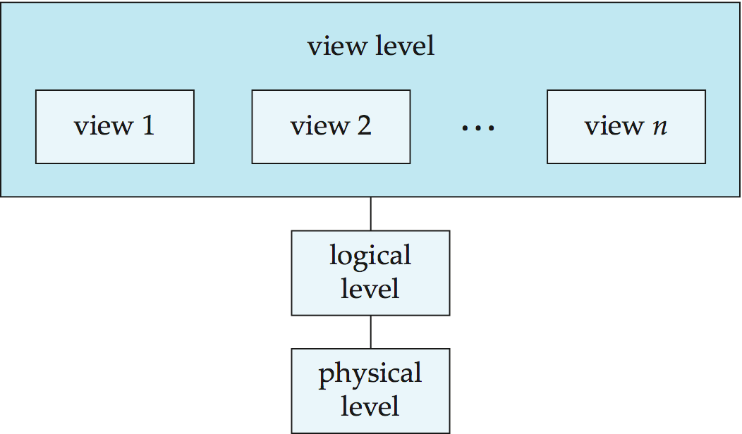
Views of Data
An architecture for a database system
Notes:
24

Slide 25
Levels of Abstraction
View level: hide details of data types and can also hide information (such as an employee’s salary) for security purposes.
Different people has different views for the same data:
Example: different groups see University Database from different perspectives:
Students: course registration information
Human resources: payroll information
Logical level: describes WHAT data is stored in database, and the relationships among the data.
type instructor = record
ID : string; name : string; dept_name : string; salary : integer;
End
Physical level: describes how a record (e.g., customer) is stored on desk.
Notes:
25

Slide 26
Why Degrees of Abstraction?
Helpful in integrating multiple (and sometimes conflicting) views of data seen at different levels of the organization
Layered architecture
Simplifies the design considerably
Enables different role players to effectively work at various levels of abstraction
Example:
What does a bank VP need?
What does a bank manager need?
What does a cashier need?

Slide 27
Data Modeling
The first step towards database design
Data modeling means to define and analyze the requirements that are needed to support the business process of an organization:
Data modeling organizes data for various users
A model is an abstraction of a real-world object or event
Useful in understanding complexities of the real-world environment
Student ➔ ID, First Name, Last Name, Address, DOB, Login
A data model is a simple representation (usually graphical) of a more complex real world-object or event.
Notes:
27

Slide 28
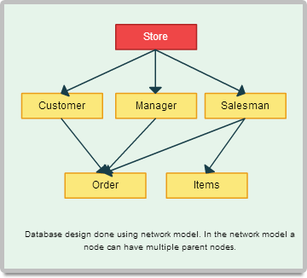

Slide 29
Why Data Modeling is needed?
Data is viewed in different ways by different people
Example:
Company president has a universal view of the data in order to tie the company’s divisions
Purchasing manger is concerned about cost of items and relationships with suppliers
Inventory manager is concerned about the inventory levels
Application programmers are concerned about data formatting, location, and reporting requirements
A data model is used to put an overall view of the company:
Data is modeled after all views are gathered
Note that a data model is ONLY an abstraction
Cannot draw required data out of the data model
Structure vs. Contents

Slide 30
Instances and Schemas
Similar to type and value of a variable in programming languages
Schema – the logical structure of the database
Example: The database consists of information about a set of customers and accounts and the relationship between them
Analogous to type of a variable in a program
Physical schema: database design at the physical level
Logical schema: database design at the logical level
Instance – the actual content of the database at a particular point in time
Analogous to the value of a variable
Instances change frequently, however schemas are changed infrequently
Notes:
30

Slide 31
Data Model Components
Structure of the data:
Description of the data structures that will be used to store data
Similar to arrays, structs, and objects in programming
Operations on the data:
Data manipulation to support real world transformations of data
Allowed data modifications and retrieval
Constraints on the data:
Limitations on what the data can be
Set of enforceable rules to guarantee the integrity of the data
Example:
0 < GPA < 4
Phone number is a 10-digit number

Slide 32
Importance of Data Models
Represents a communication tool that facilitates interaction among:
Database Designer
Professional database programmer
Casual database user
Improved understanding of the organization:
How all the pieces of an organization fit together

Slide 33
Basic Building Blocks
Entity: any object about which data are to be collected and stored
Example: Person, Student, Customer, Course, Place
Attribute: a characteristic of an entity
Example: student’s last name, first name, phone number
Relationship: describes an association among entities
Example: A customer can be served by one agent, and an agent can serve many customers
Constraint: a restriction placed on the data
Important to ensure data integrity
Example:
Student’s GPA is between 0 and 4
Each class have one and only one teacher
Notes:
33
33

Slide 34
Example Data Models
Flat file system
Hierarchical Model
Network Model
Relational Model
Entity Relational Model
Object-Oriented model
Semi-structured data model (XML)

Slide 35
The Relational Model
Developed by E. F. Codd (IBM) in 1970
The current standard for database modeling where each entity is represented by a relation (i.e., a table)
Relation (Table):
Matrix consisting of row/column intersections
Each column represents an attribute
Each row in a relation called a tuple
Logical structure
attribute
SID
Name
Login
DEPT
GPA
53666
Jones
jones@cs
CS
3.4
tuple
53688
Smith
smith@eecs
EE
3.2
53650
Smith
smith@math
MA
3.8
Notes:
35
35

Slide 36
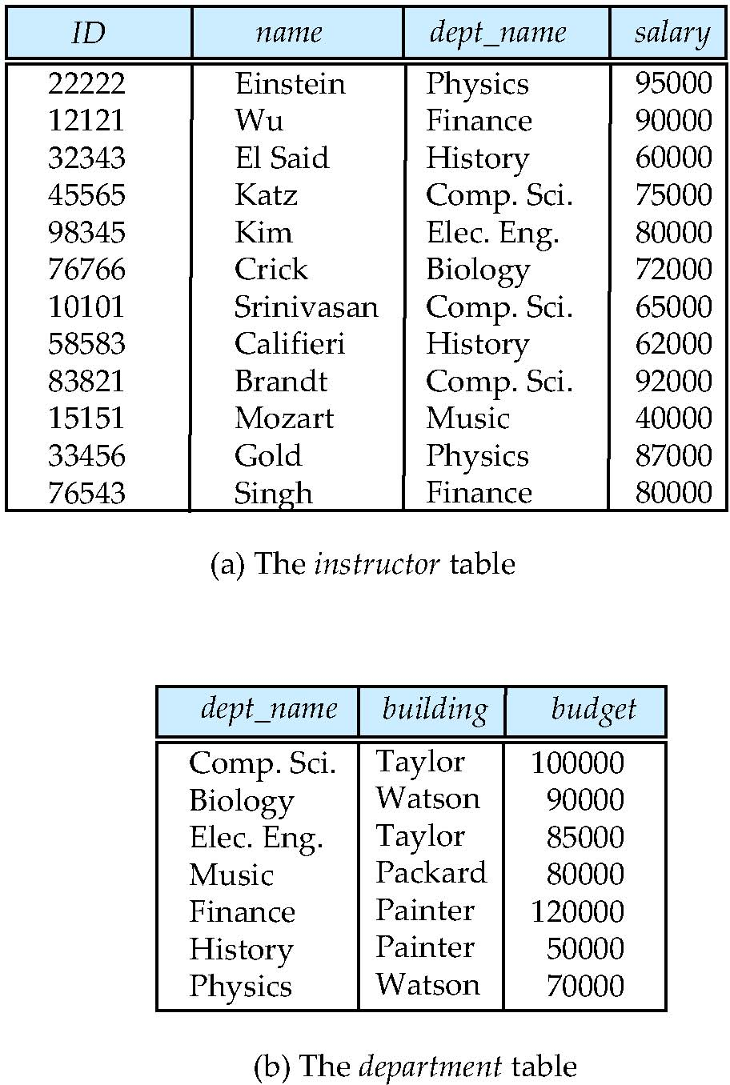
Example of The Relational Model
Relational model (Chapter 2)
Example of tabular data in the relational model
Columns
Rows
Notes:
36

Slide 37
A Sample Relational Database
Notes:
37

Slide 38
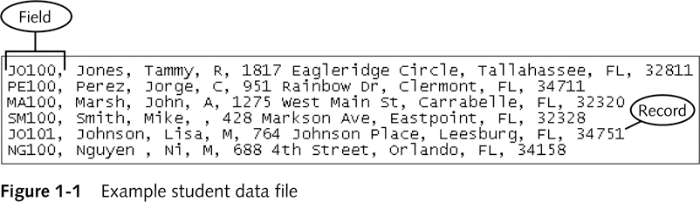
What is the difference between a table and a file?
A table is a logical structure but a file is physical entity
A table is stored in a file
Tables provide data and structure independence:
How the table contents (row/record) are physically stored in the file is of no concern to the table’s user or designer

Slide 39
Advantages of the Relational Model
Controlled Data redundancy:
Entities (tables) are related through relationships
Example:
Department information is not stored with each instructor
However, department’s information of a given instructor is retrieved by following the relationship between Instructor table and Department table
Powerful and flexible query language:
Structure Query Language (SQL)
SELECT name
FROM instructor
WHERE dept_name= Physics
Specify WHAT must be done not HOW to do it

Slide 40
Database Languages
Data Definition Language (DDL)
Used to create the database schema (i.e, Create tables).
Data Manipulation Language (DML)
Used to express database queries and updates:
Retrieval of information stored in the database
Insertion of new information into the database
Deletion of information from the database
Modification of information stored in the database

Slide 41
Data Definition Language (DDL)
Used to define the database schema
Example:
CREATE TABLE instructor( ID char(5), name varchar(20), dept_name varchar(20), salary numeric(8,2))
DDL is also used to define:
Storage requirements
Consistency constraints
Example: account balance of a department must never be negative
DDL compiler generates a set of table metadata that is stored in the data dictionary
Notes:
41

Slide 42
Data Dictionary
A Data dictionary contains metadata (i.e., data about data) about:
Database schema
Integrity constraints
Primary key (ID uniquely identifies instructors)
Referential integrity (references constraint in SQL)
Example: dept_name value in any Instructor tuple must appear in Department table

Slide 43
Integrity Constraints
Domain Constraints:
A domain of possible values for each attribute (e.g., integer, character or date)
Tested by the system whenever a new entry is entered in the database
Referential Integrity:
Relationship between two relations
Example:
before associating a department to a student, the department must exist in the Department table

Slide 44
Integrity Constraints (continued)
Assertions:
Any condition that the database must always satisfy
Example: Each department must offer at least five course each semester
The system validates that any update to the database does not violate the assertion
Authorization:
Specify different access permissions for different users
Examples:
Read authorization
Insert authorization
Update authorization
Delete authorization

Slide 45
Data Manipulation Language (DML)
Language for accessing and manipulating the data organized by the appropriate data model
DML also known as Query Language
Two classes of languages
Procedural – user specifies WHAT data is required and HOW to get those data
Declarative (nonprocedural) – user specifies WHAT data is required without specifying how to get those data
SQL is the most widely used declarative query language
Notes:
45

Slide 46
Structured Query Language (SQL)
SQL is a widely used declarative query language
Example 1: Find the name of the instructor with ID 22222 SELECT name FROM instructor WHERE instructor.ID = ‘22222’
Example 2: Find the ID and building of instructors in the Physics dept.
SELECT instructor.ID, department.building FROM instructor, department WHERE instructor.dept_name = department.dept_name and department.dept_name = ‘Physics’
Application programs generally access databases through:
Language extensions to allow embedded SQL, or
Application program interface (e.g., ODBC/JDBC) which allow SQL queries to be sent to a database
Notes:
46

Slide 47
Steps for Designing a Database
Requirement analysis
An informal discussion with the customers
Understand what are the requirements, how different entities relate to each other, what are the frequent operations to be performed
Conceptual Database Design
Develop a high-level description of the data
Develop an entity-relationship model that capture the semantics of the data
Internal Database Design
Convert the conceptual schema into a (relational) database schema

Slide 48
Steps for Designing a Database (Cont’d)
Model Refinement
Identify potential problems in your design
This process can be guided by some elegant and powerful theory (Normalization)
Physical Database Design
Study the expected workload of the system
Tune the performance by building indexes and clustering tables
Application and Security Design
Identify which parts of the database are accessible to whom
Notes:
48

Slide 49
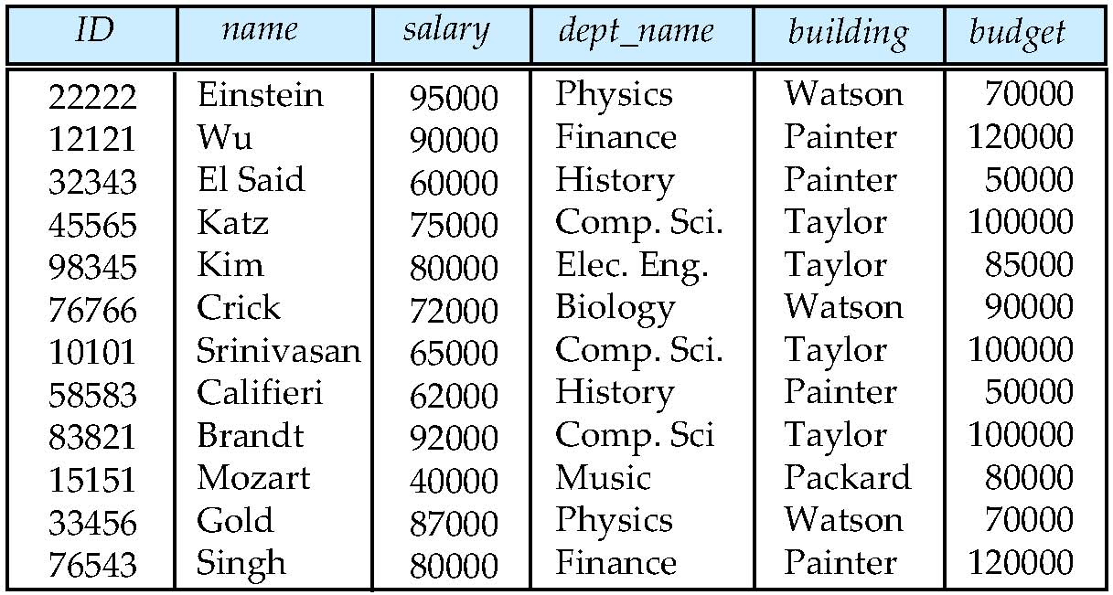
Database Design?
Is there any problem with this design?
Notes:
49

Slide 50
Design Approaches
Entity Relationship Model (Chapter 7)
Models an enterprise as a collection of entities and relationships
Entity: a “thing” or “object” in the enterprise that is distinguishable from other objects
Described by a set of attributes
Relationship: an association among several entities
Represented diagrammatically by an Entity Relationship Diagram (ERD)
Normalization Theory (Chapter 8)
A formal process to test how good a data base design is
Notes:
50

Slide 51
The Entity Relationship Diagram (ERD)
Graphical representation for the Relational Data model
Entity Relationship Diagram (ERD):
Entity:
Corresponds to a relation in the relational model
Each row is called “entity instance”
Represented by a rectangle
Defined by a set of attributes
Relationship:
Association between two entities
Connectivity is the type of the relationship (1:1, 1:M, M:N)
Notes:
51
51

Slide 52
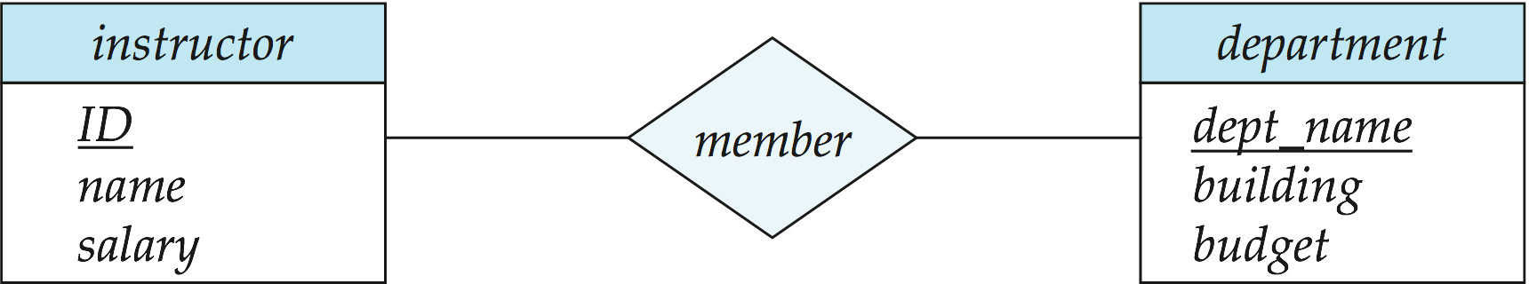
Example Entity-Relationship Model
What happened to dept_name attribute of the instructor table?
Notes:
52

Slide 53
Relationship Connectivity
One-to-many (1:M) relationship
A customer can be served by one agent, and an agent can serve many customers
A painter can paint many paintings, one painting is painted by one painter.
A customer can generate many invoices, an invoice is issued to one customer
Many-to-many (M:N or M:M) relationship
A student can take many classes, and a class can be taken by many students
An employee can learn many skills, a skill can be learned by many employees
One-to-one (1:1) relationship
Each department has one manager and each manger manages one department
53

Slide 54
Example Relationships
In how many classes can one student enroll? Answer: many classes
How many students can enroll in one class? Answer: many students
StudentID
SName
M
Students
Advices
M
1
FacultyID
Enrollment
Faculty
FName
1
M
M
Courses
Teaches
CourseID
CName

Slide 55
Storage Management
The Storage Manager is a program module that provides the interface between the low-level data stored in the database and the application programs and queries submitted to the system.
The storage manager is responsible for the following tasks:
Interaction with the file manager
Efficient storing, retrieving and updating of data
Issues to be addressed by the storage manager:
Storage access (authorizations)
File organization (file manager and buffer manager)
Indexing and hashing (provide fast access to data items)
Notes:
55

Slide 56
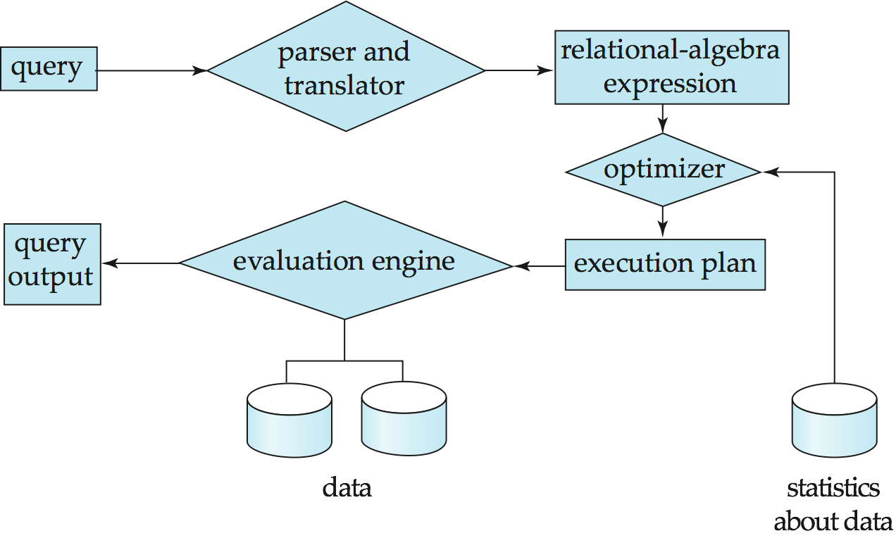
Query Processing
1. Parsing and translation
2. Optimization
3. Evaluation
Notes:
56

Slide 57
Query Processing (Cont’d)
Alternative ways of evaluating a given query
Equivalent expressions
Different algorithms for each operation
Cost difference between a good and a bad way of evaluating a query can be enormous
Need to estimate the cost of operations
Depends critically on statistical information about relations which the database must maintain
Need to estimate statistics for intermediate results to compute cost of complex expressions
Notes:
57

Slide 58
Transaction Management
A transaction is a collection of operations that performs a single logical function in a database application
What if the system fails in middle of executing a transaction?
What if more than one transaction is concurrently updating the same data?
Transaction-management component ensures that the database remains in a consistent (correct) state despite system failures (e.g., power failures and operating system crashes) and transaction failures.
Notes:
58

Slide 59
Transaction Manager
Maintains ACID properties of a transaction:
Atomicity
Consistency
Isolation
Durability
Two modules:
What if more than one transaction is concurrently updating the same data?
Concurrency-Control manager
What if the system fails in middle of executing a transaction?
Recovery manager

Slide 60
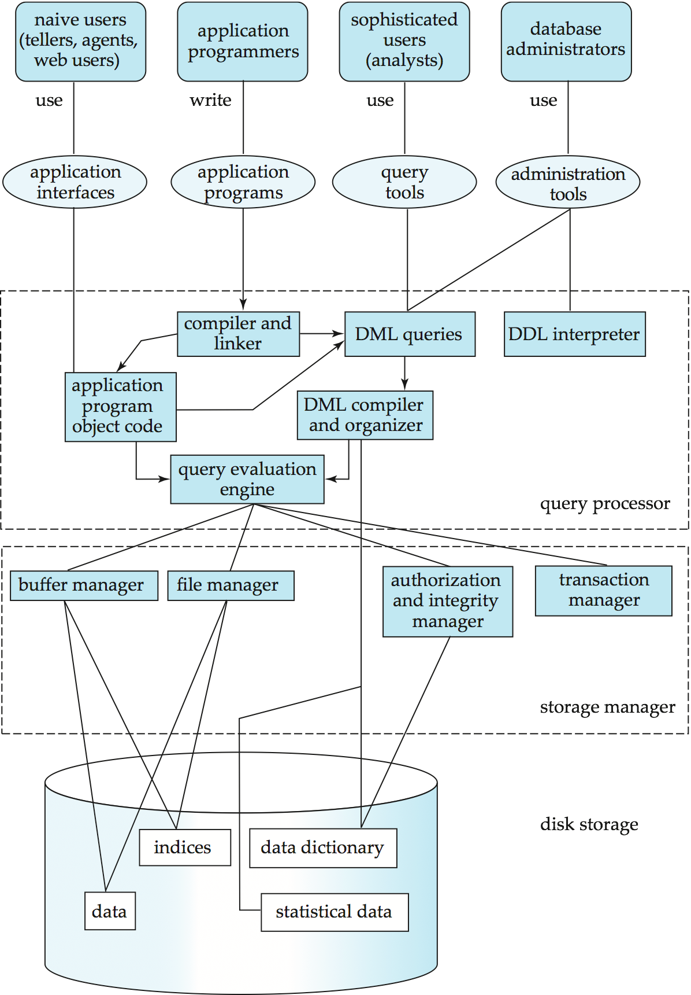
Database System Internals
Notes:
60

Slide 61
A Bird’s Eye View of DBMS
Create Tables
DB Application Programmer
DB Casual User
Enter Data
Queries: Find all students who are enrolled in CS101
SQL
SELECT StudentID
FROM Enrollement
Where CourseID = CS101
Java / C++
Course Information
Enter Course ID
DBMS
Student_Id
SName
Data Model
DB Designer
Query Parser
10032
Adam
DB Administrator
Tuning
10554
Joe
StudentID
SName
10345
Lina
Query Optimizer
Handles security and authorization
Data availability, crash recovery
Database tuning as needs evolve
DB Developer
Students
Course_Id
CName
Query Operators
CS101
DB
CS122
Math
Student_Id
Course_ID
Enrollment
Index
10345
CS101
10051
CS101
Courses
Disk
CourseID
CName

Slide 62
Roadmap
Database Designer:
Introduction to the Relational Model (Chapter 2)
Database Design and the Relational Mode (Chapters 7 and 8)
Database Programmer:
Introduction to SQL (Chapter 3)
Intermediate SQL (Chapter 4)
Design database applications for Casual Users:
Advanced SQL (Chapter 5)
Human Computer Interaction
Database Administrator:
Transaction Management (Chapter 14)
Concurrency Control (Chapter 15)
Recovery (Chapter 16)
Indexing (Chapter 11)
Database systems developers:
Query Evaluation and Optimization

Slide 63
Summary
Problems of using the file system for data storage
Database Management Systems
Degrees of Abstraction
Database Design
Data Modeling
The relational Model
The Entity Relational Diagram (ERD)
Query Language:
Data Manipulation Language (DML)
Data Definition Language (DDL)
Storage Manager
Transaction Manager

Slide 64
Reading and Assignment
No. | Date | Topics and Required Reading | Assignments | Due Date by
 |  |  |  | start of class day
1 | 16-Jan-2020 | Review Course Syllabus Introduction to Database Management Systems | Chapter 2 - Relational Model Chapter 6 Section 6.1 Homework #1 Relational DB
2 | 23-Jan-2020 | Introduction to the Relational Model Review Project Step 1 | Chapter 7 - DB Design & ERD Reminder Homework #1 Project Step 1
3 | 30-Jan-2020 | Database Design Relational model (ERD) | Chapter 8 - Database Design Normalization_Note Homework #2 ERD | Homework # 1 Relational DB
4 | 6-Feb-2020 | Normalization | Chapter 3 - Intro to SQL Homework#3 Normalization Reminder: Project Step 1 | Homework #2 ERD
5 | 13-Feb-2020 | Introduction to SQL - Part 1 | Chapter 3 - Intro to SQL Homework #4 SQL I | Homework#3 Normalization
6 | 20-Feb-2020 | Introduction to SQL – Part 2 Review Project Step 2 | Chapter 4 - Intermediate SQL Homework#5 SQL II | Homework#4 SQL I

